Slide 1
Morphological Classification of Extragalactic Radio Sources Using Convolutional Neural Networks (CNNs)

Slide 2
PROJECT OBJECTIVE
Classify radio galaxy images into three classes: FR0, FRI, and FRII.

Slide 3
MOTIVATION
Understanding radio galaxy types is crucial for astronomy and space science.

Slide 4
APPROACH
Utilize Convolutional Neural Network (CNN) and ResNet to distinguish between galaxy classes using image data.

Slide 5
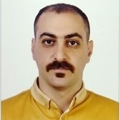



GROUP MEMBERS
Seyed Ali Rashidi
Forouzan Rezaei
Sachin Prakash
Jeremiah Daniel Effiong

Slide 6
Introduction
Radio galaxies are a special type of galaxy that produces large amounts of energy in the form of radio waves.
This energy comes from supermassive black holes at the center of these galaxies, which shoot out jets of particles moving close to the speed of light.
When these jets interact with the surrounding space, they create different shapes, or morphologies, that scientists can observe with radio telescopes.

Slide 7
Types of Radio galaxies
FR0 galaxies are compact, with no extended jets, and most of their radio emission concentrated near the core.
FRI galaxies have jets that are brightest near the galactic core and fade outward, often found in dense environments like galaxy clusters.
FRII galaxies feature long, collimated jets that end in bright hotspots, with more extended emission regions, and are found in more isolated environments.

Slide 8
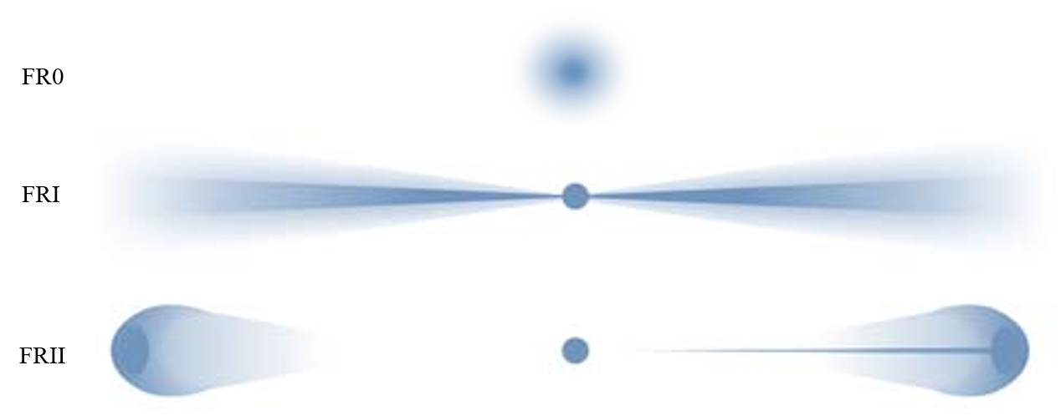

Slide 9
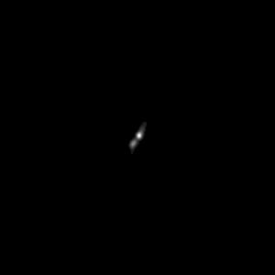
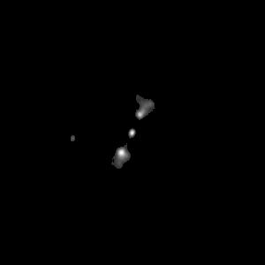
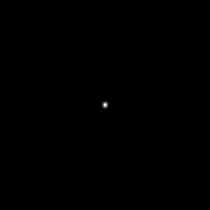
FR0
FRI
FRII

Slide 10
Roadmap
Dataset Overview
Class Imbalance and Data Augmentation
Convolutional Neural Network (CNN)
1
3
5
2
4
6
Data Loading and Preprocessing
Sobel Edge Detection and Symmetry Analysis (SSIM)
Hyperparameter Optimization with Optuna

Slide 11

Dataset Overview

Slide 12
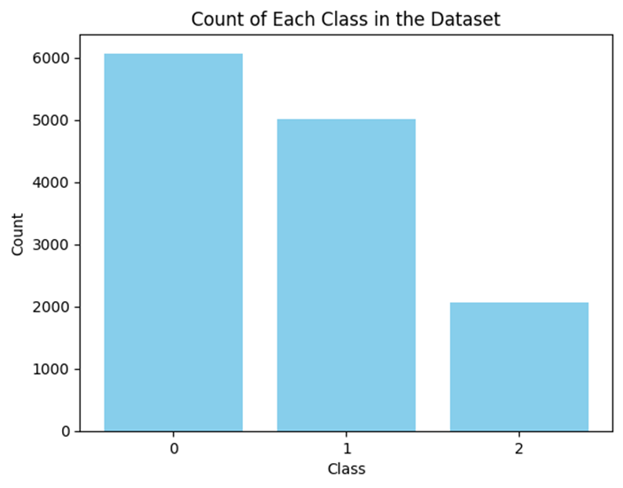
Data Distribution

Slide 13
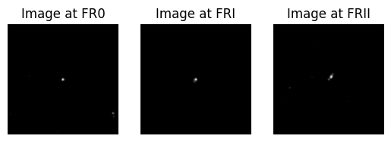
Sample Images

Slide 14

Data Pre-processing

Slide 15

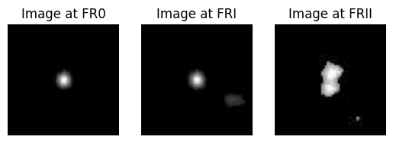
Cropping

Slide 16
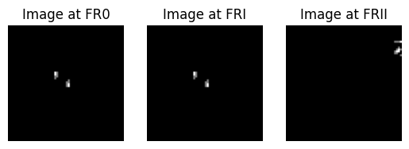
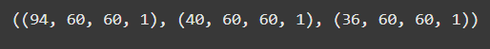
Filtering

Slide 17
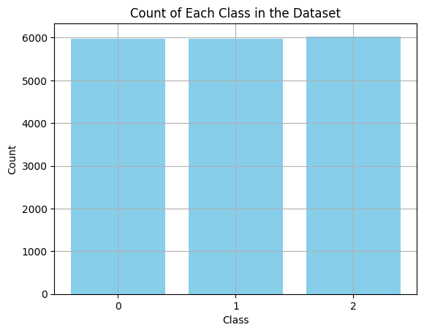
Data Augmentation

Slide 18
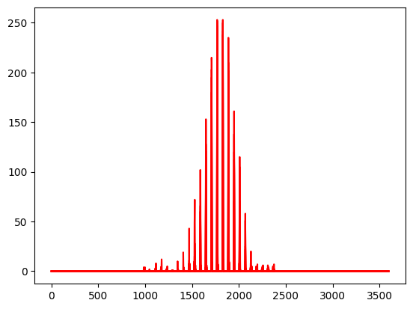
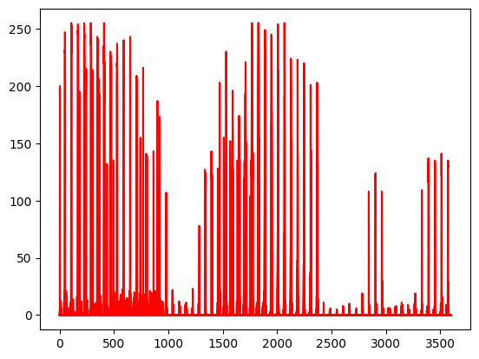
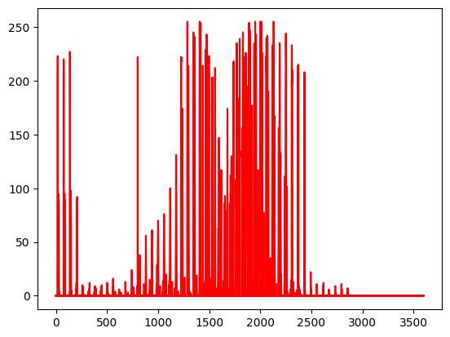
Flattening

Slide 19
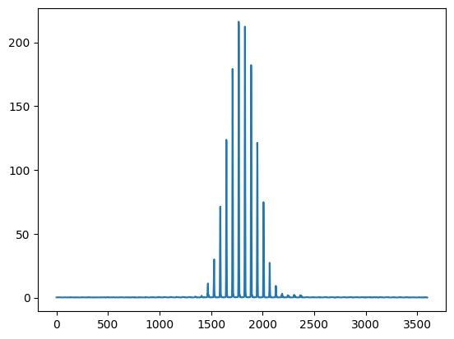
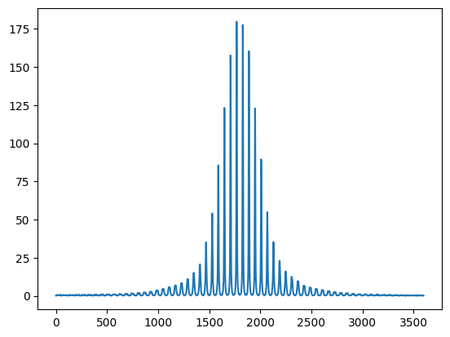
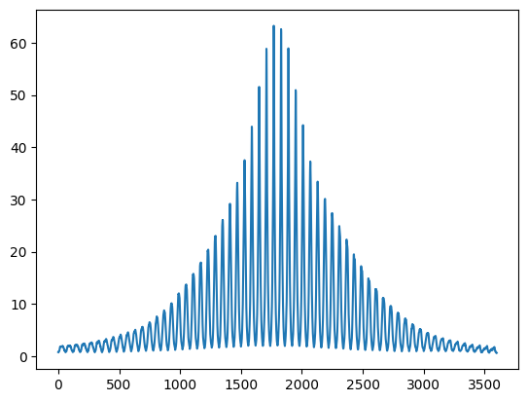
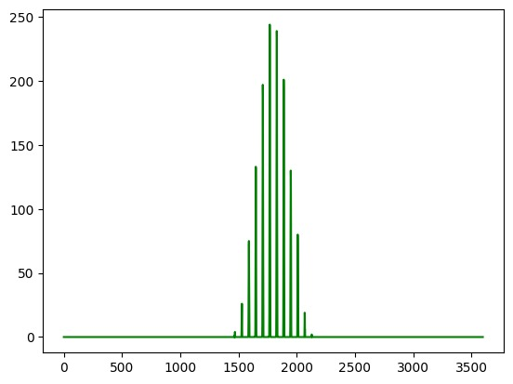
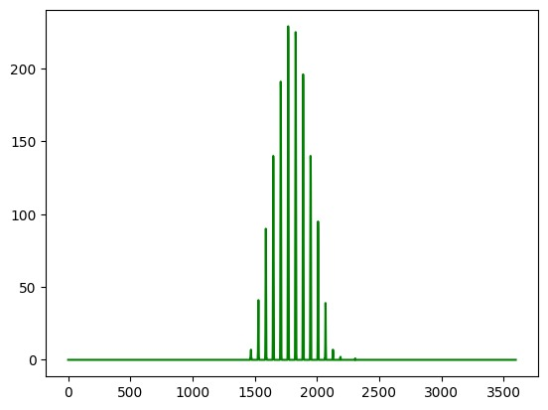
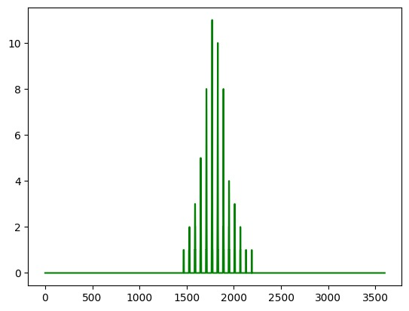
Pixels mean and median
Mean
Median

Slide 20
Pixels Correlation

Slide 21
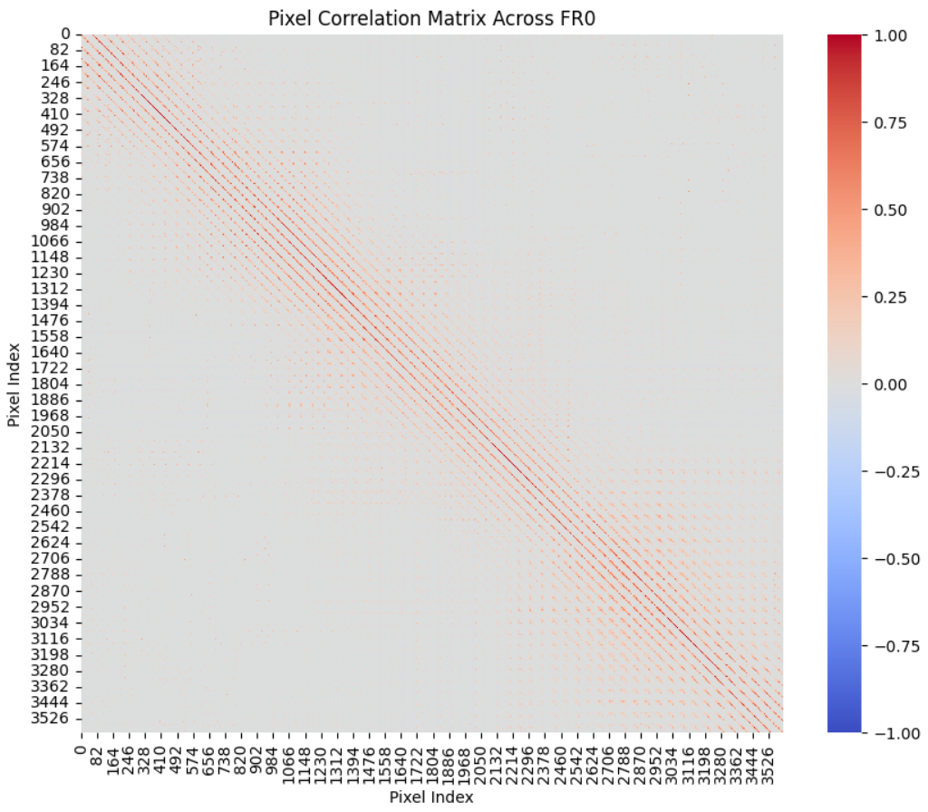
FR0

Slide 22
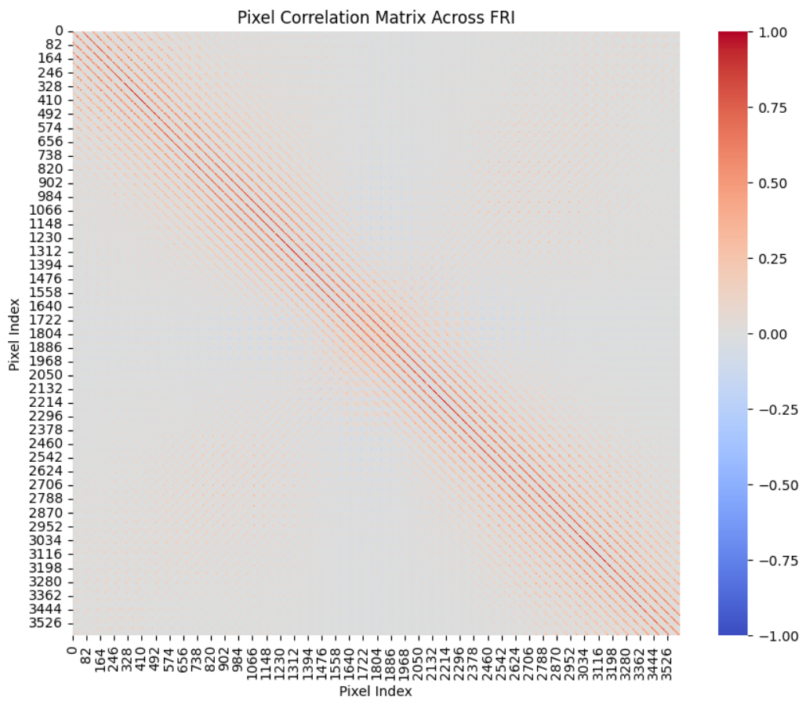
FRI

Slide 23
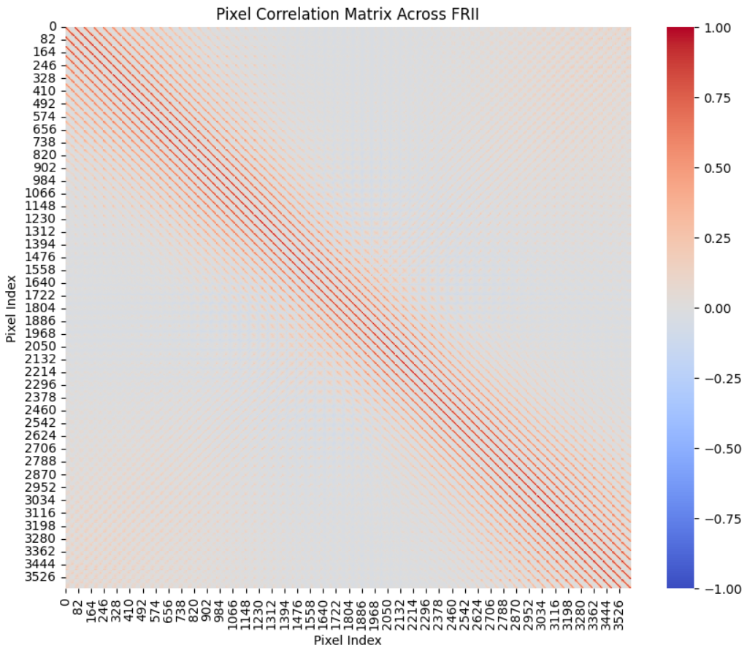
FRII

Slide 24
Sobel Edge Detection

Slide 25
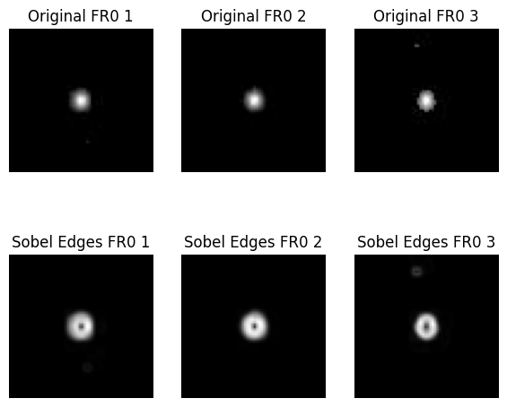

Slide 26
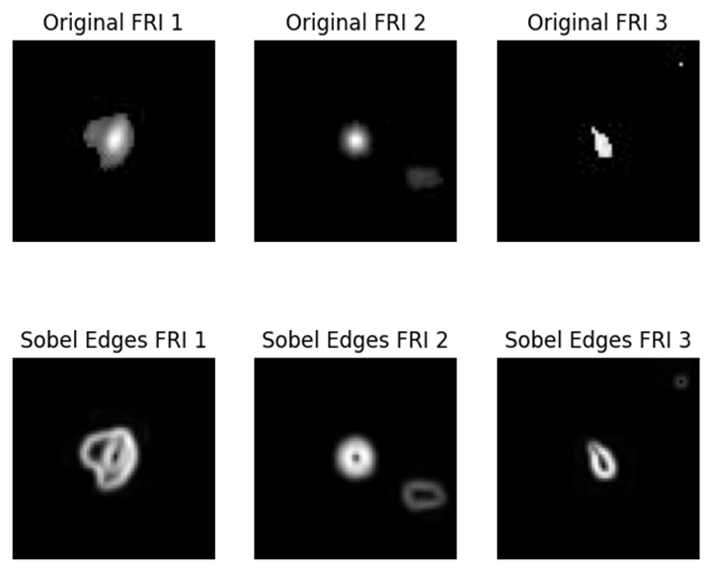

Slide 27
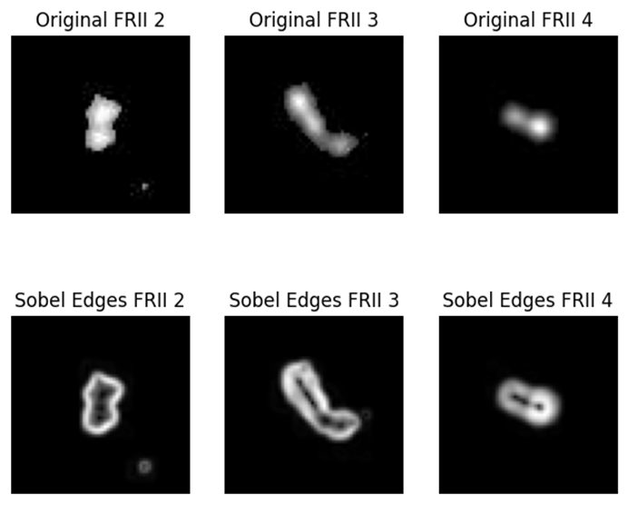

Slide 28
Symmetry Analysis

Slide 29
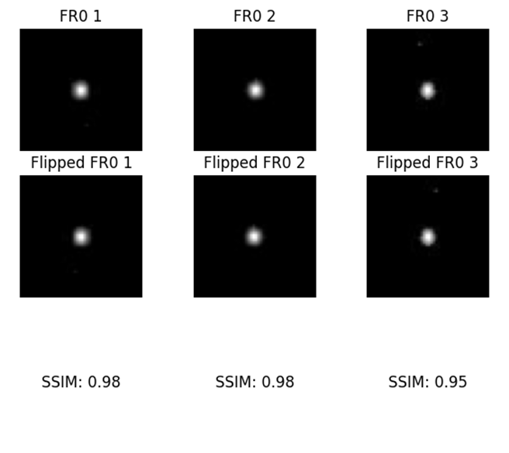

Slide 30
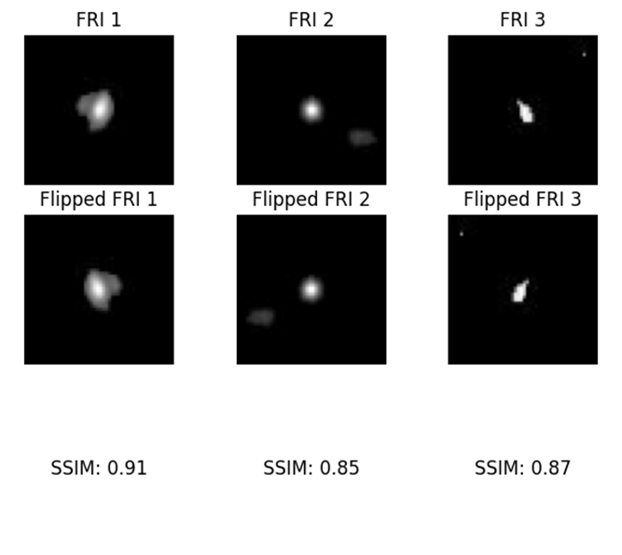

Slide 31
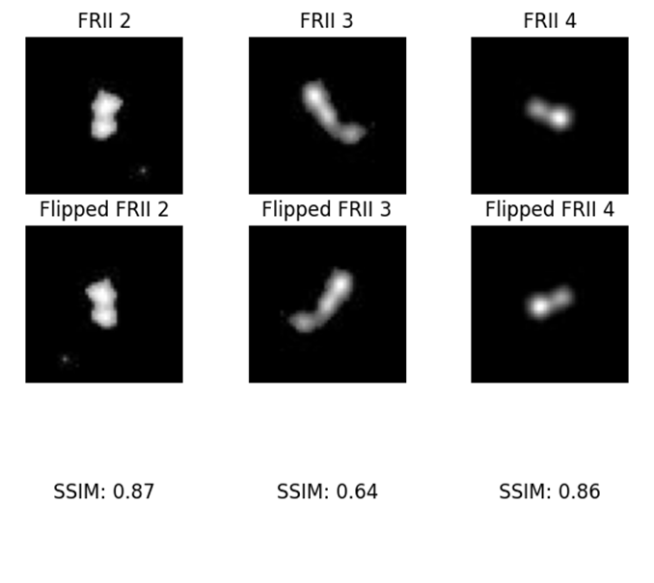

Slide 33
Convolutional Neural Network Architecture
Model Type: Sequential CNN

Slide 34
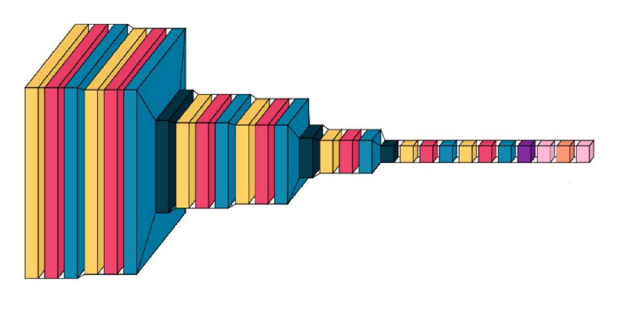
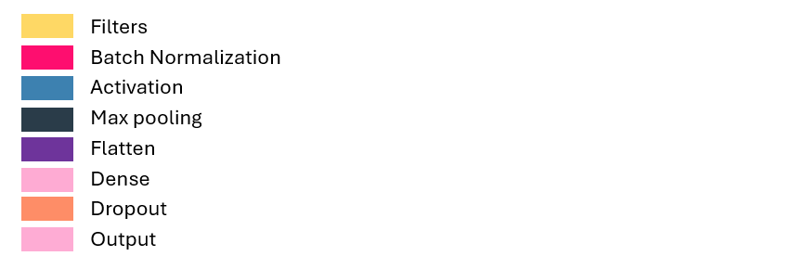
256 * 4
512 * 4
128 * 5
...

Slide 35
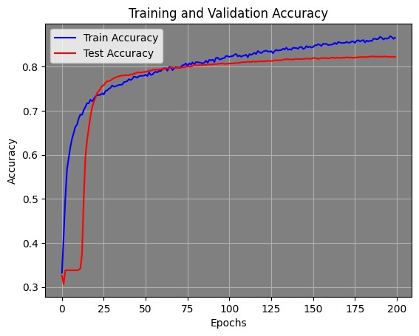
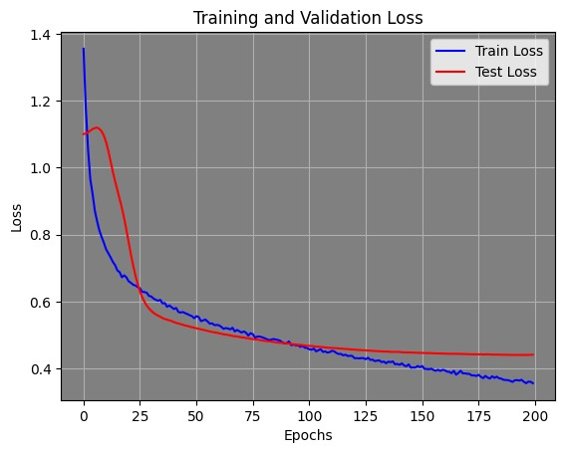
Training and Validation Plots

Slide 36

CNN Model Evaluation

Slide 37
Accuracy and Loss
Test acc: 82.77 loss:43.72
Train acc: 87.39 loss: 32.7

Slide 38
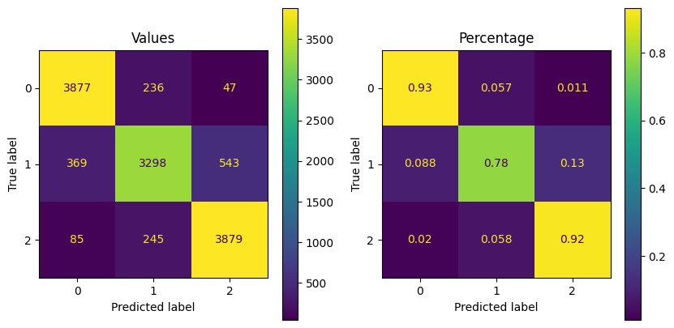
Confusion Matrix (Training Set)

Slide 39
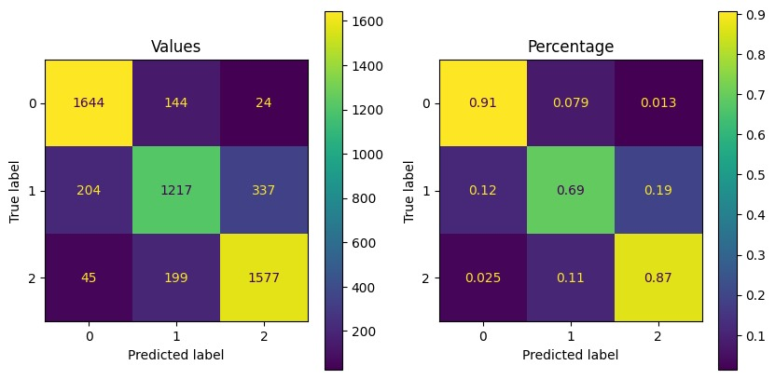
Confusion Matrix (Test Set)

Slide 40
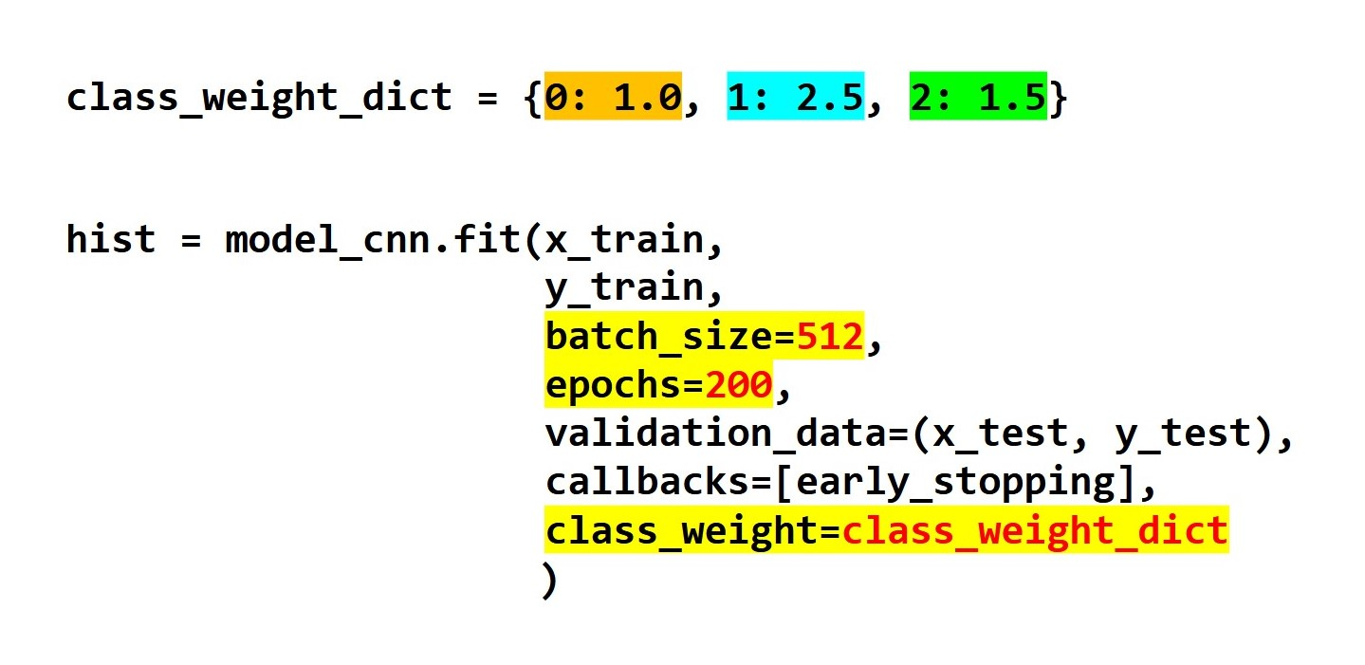
CNN Model Training

Slide 41
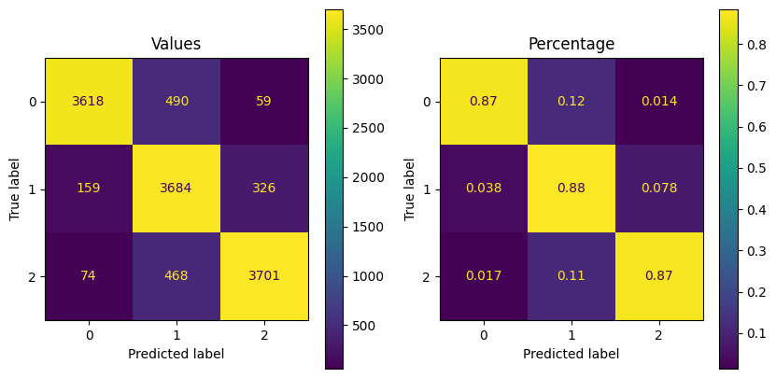
Confusion Matrix (Training Set)

Slide 42
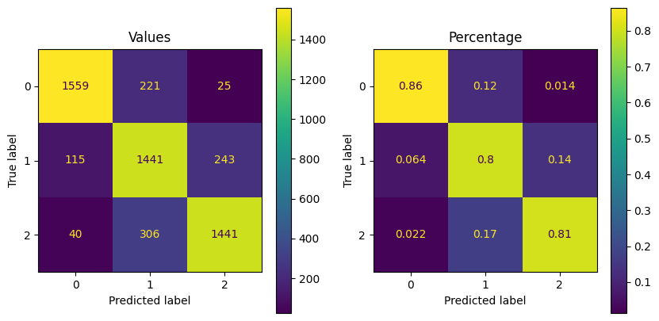
Confusion Matrix (Test Set)

Slide 43
Confusion Matrix (Test Set)
After
Before

Slide 44
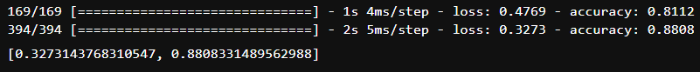
Accuracy and Loss (After weights)
Test acc: 81.12 loss:47.69
Train acc: 88.08 loss: 32.73

Slide 45

OPTUNA
Hyperparameter optimization

Slide 46
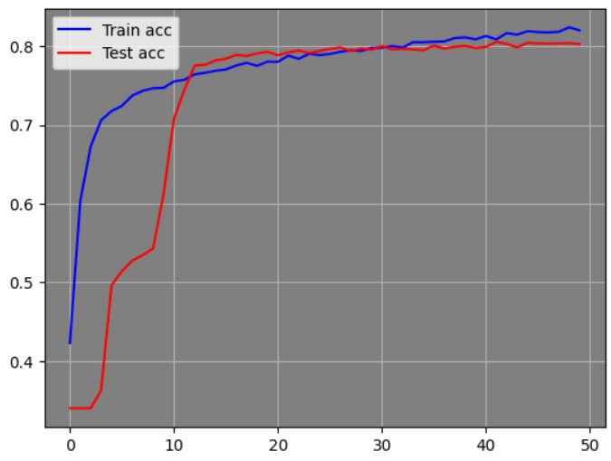
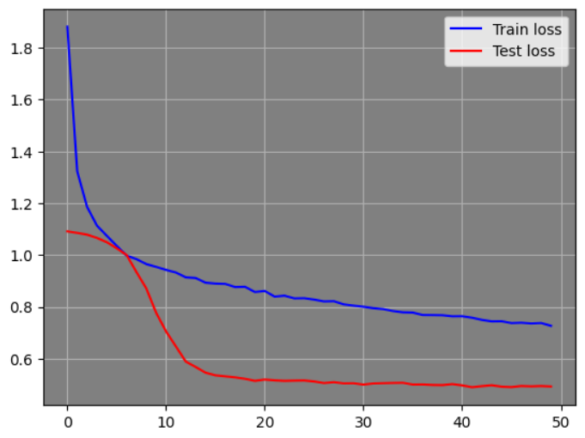
Training and Validation Plots

Slide 47
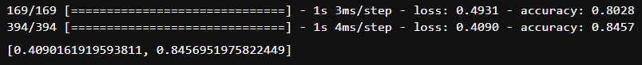
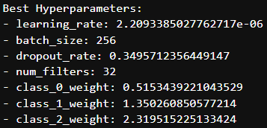
Accuracy and Loss (After Optuna)

Slide 48
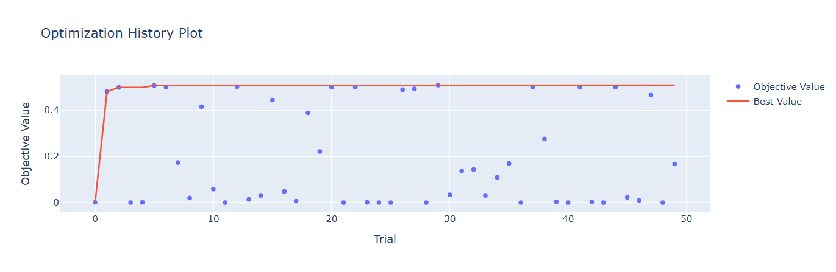
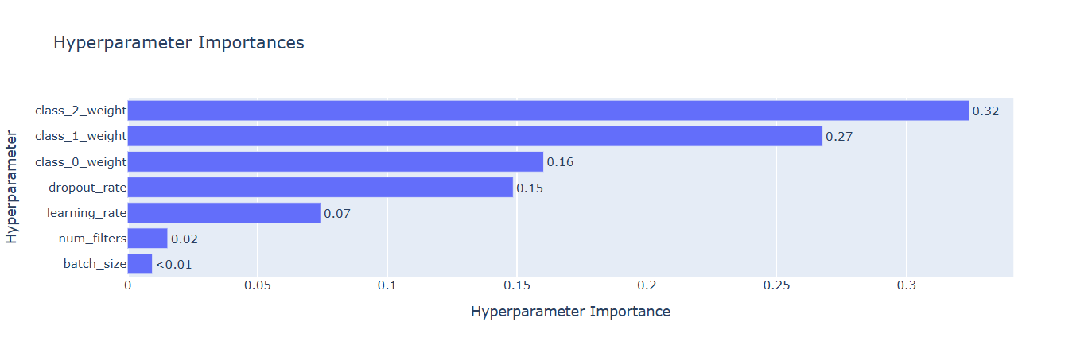

Slide 49
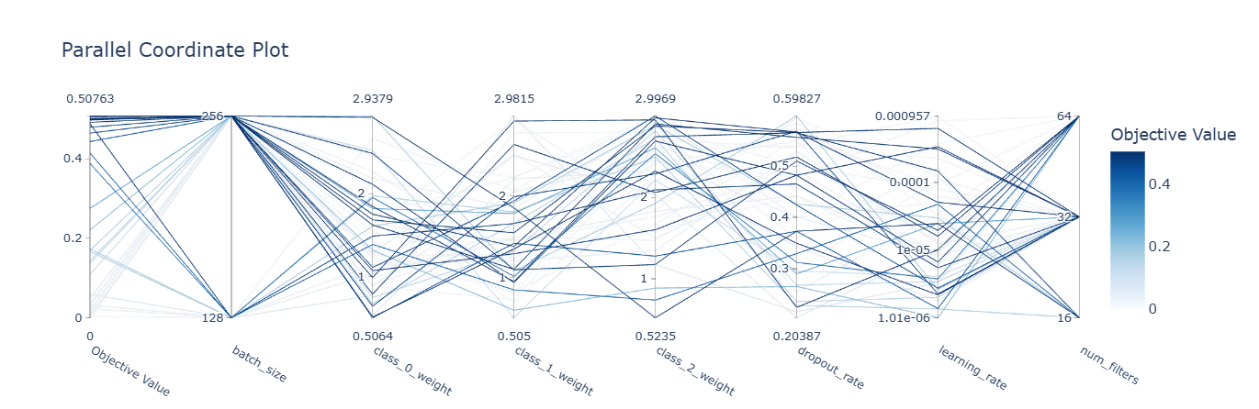

Slide 50
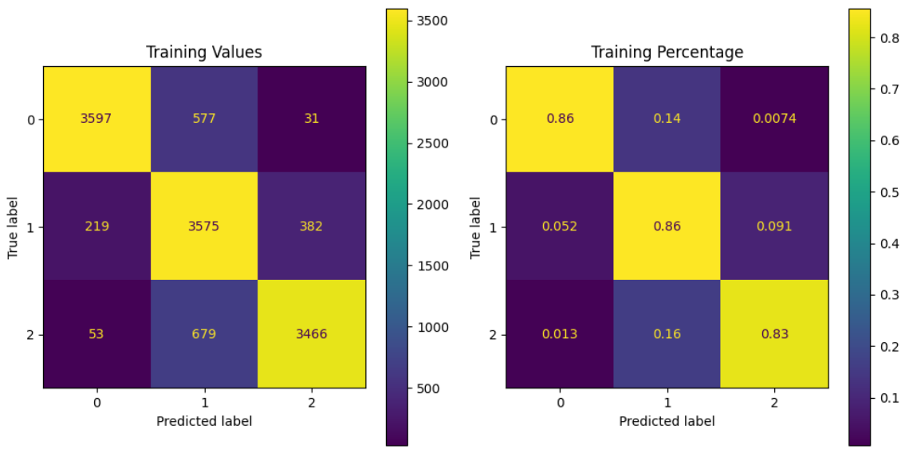
Confusion Matrix (Training Set)

Slide 51
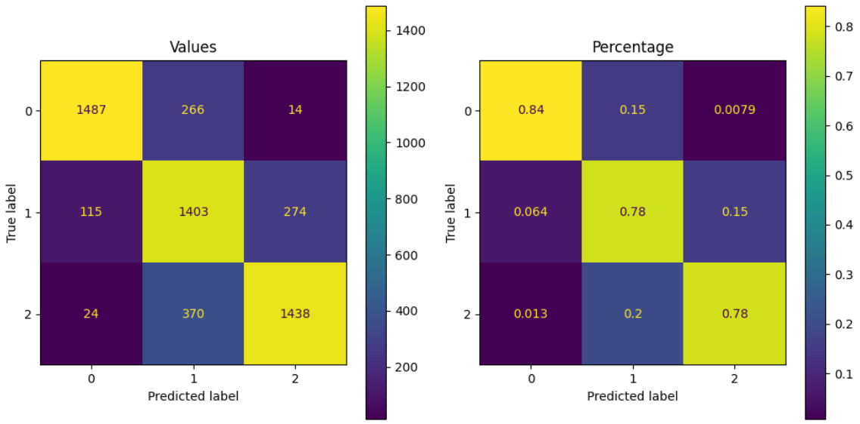
Confusion Matrix (Test Set)

Slide 52

Summary and Conclusion

Slide 53
Performance Metrics
 | CNN | Optuna | ResNet
Training Accuracy | 0.8808 | 0.8457 | 0.8451
Test Accuracy | 0.8277 | 0.8028 | 0.7781
Test Loss | 0.4769 | 0.4931 | 0.5250
Training Time | 2.46 | 34.26 | 3.12

Slide 54
Thanks!

